Slide 1
MeteoInfo and its application in HYSPLIT data analysis
Yaqiang Wang
Chinese Academy of Meteorological Sciences
Jun, 2018 in HYSPLIT workshop

Slide 2
Report content
MeteoInfo introduction
MeteoInfoMap – GIS desktop
TrajStat – Trajetory statistics package
MeteoInofLab – Scientific computation environment

Slide 3
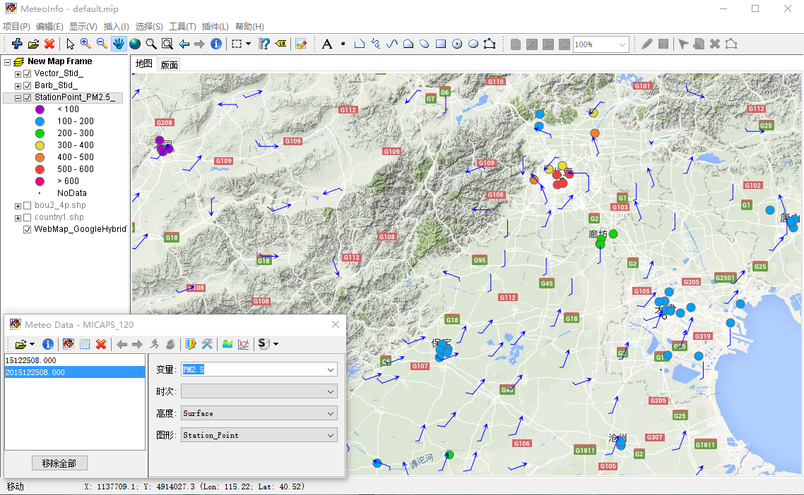
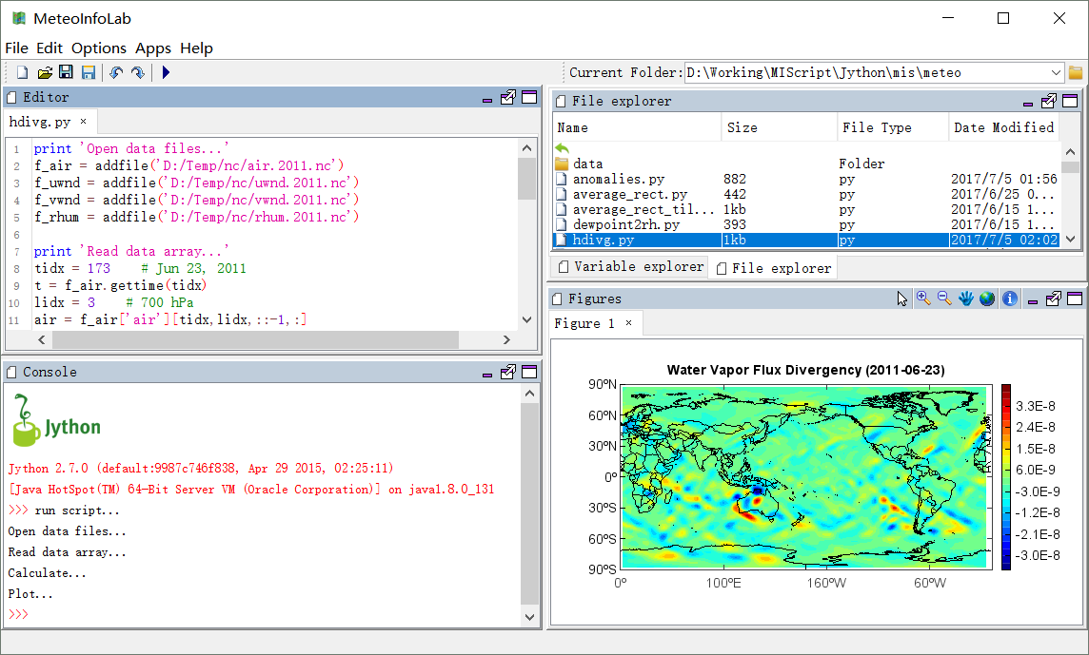
MeteoInfo
MeteoInfoMap
An intergrated framework both for GIS application and scientific computation environment – especially for meteorological community.
(Wang et al., 2014, Meteo. Appl.)
MeteoInfoLab
GIS functions
netCDF, GRIB, ARL …
Script (Jython)
Multi-dimensional array computation
2D, 3D visulization
Plugin, secondary development
Open source
Cross platform (Java)

Slide 4
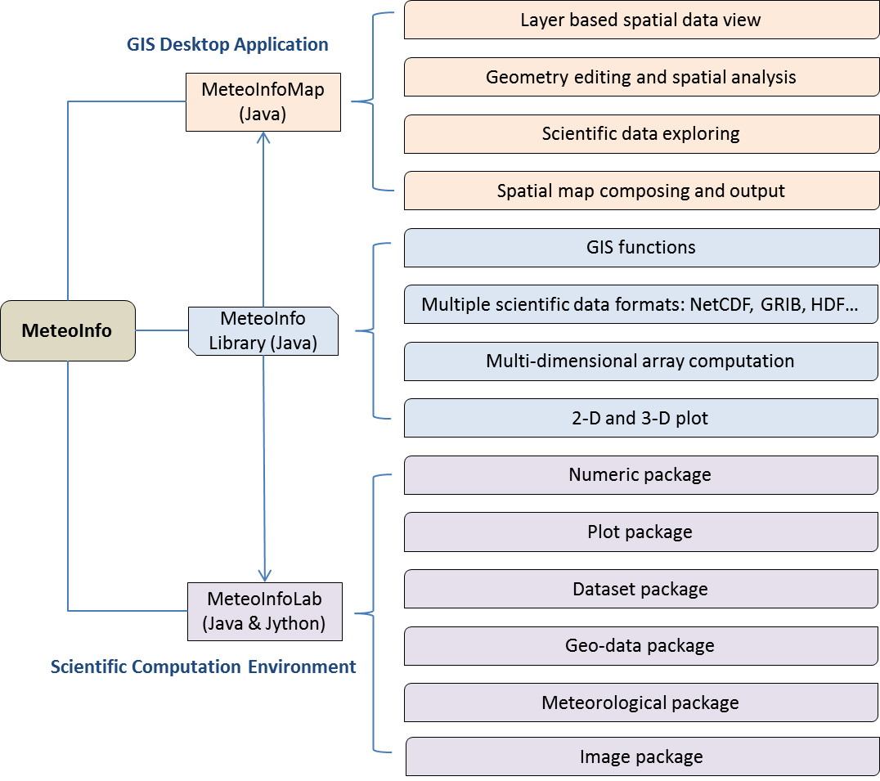

Slide 5
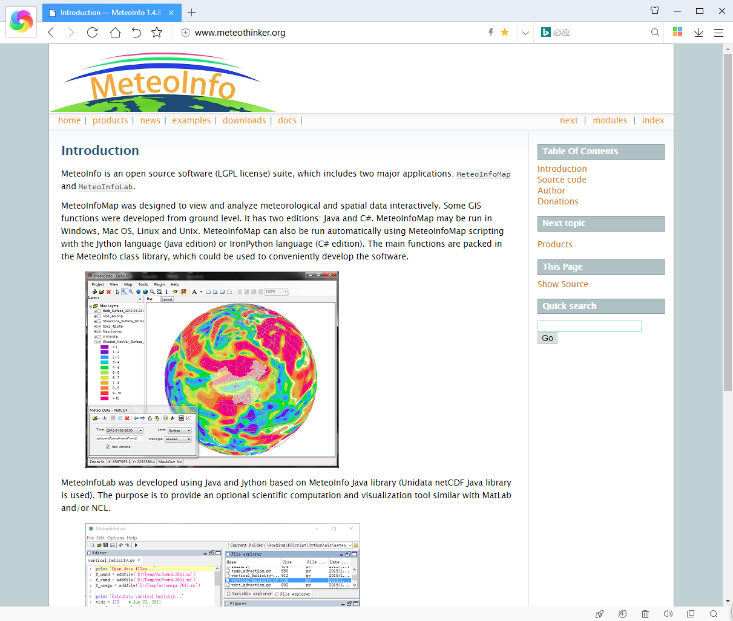
Website：http://www.meteothinker.org
Source code: https://github.com/meteoinfo

Slide 6
Third-party libraries used in MeteoInfo
NetCDF Java: Available at www.unidata.ucar.edu/software/netcdf-java
Jython: Available at http://www.jython.org/
Common Math: Available at http://commons.apache.org/proper/commons-math/
Proj4J: Available at http://trac.osgeo.org/proj4j/wiki
Groovy: Available at http://groovy.codehaus.org/
wContour: Available at http://www.meteothinker.com/
L2FProd: Available at http://common.L2FProd.com
RSyntaxTextArea: Available at http://fifesoft.com/rsyntaxtextarea/
JLaTeXMath: Available at http://forge.scilab.org/index.php/p/jlatexmath/
JavaHelp: Available at https://javahelp.java.net/
BeanShell: Available at http://www.beanshell.org/
FreeHEP VectorGraphics: Available at http://java.freehep.org/vectorgraphics/
Docking Frames: Available at http://dock.javaforge.com/
And more …

Slide 7
Report content
MeteoInfo introduction
MeteoInfoMap – GIS desktop
TrajStat – Trajetory statistics package
MeteoInofLab – Scientific computation environment

Slide 8
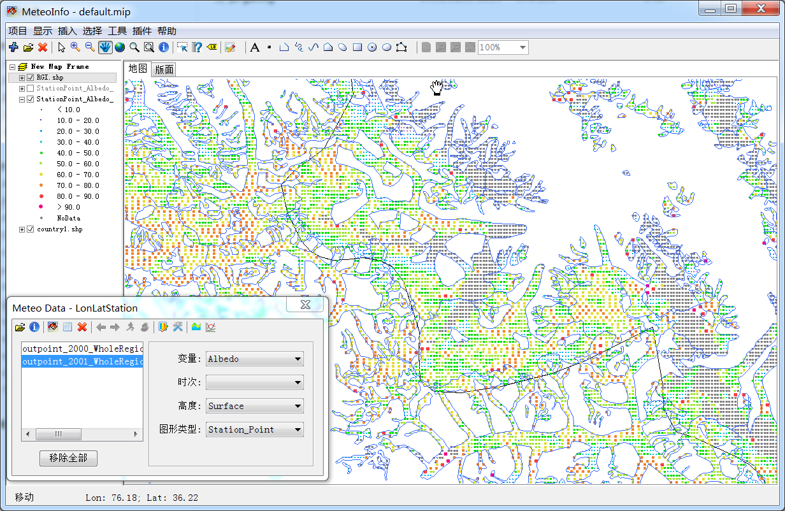
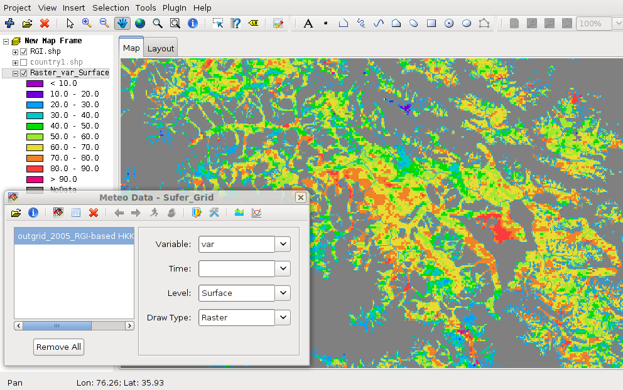
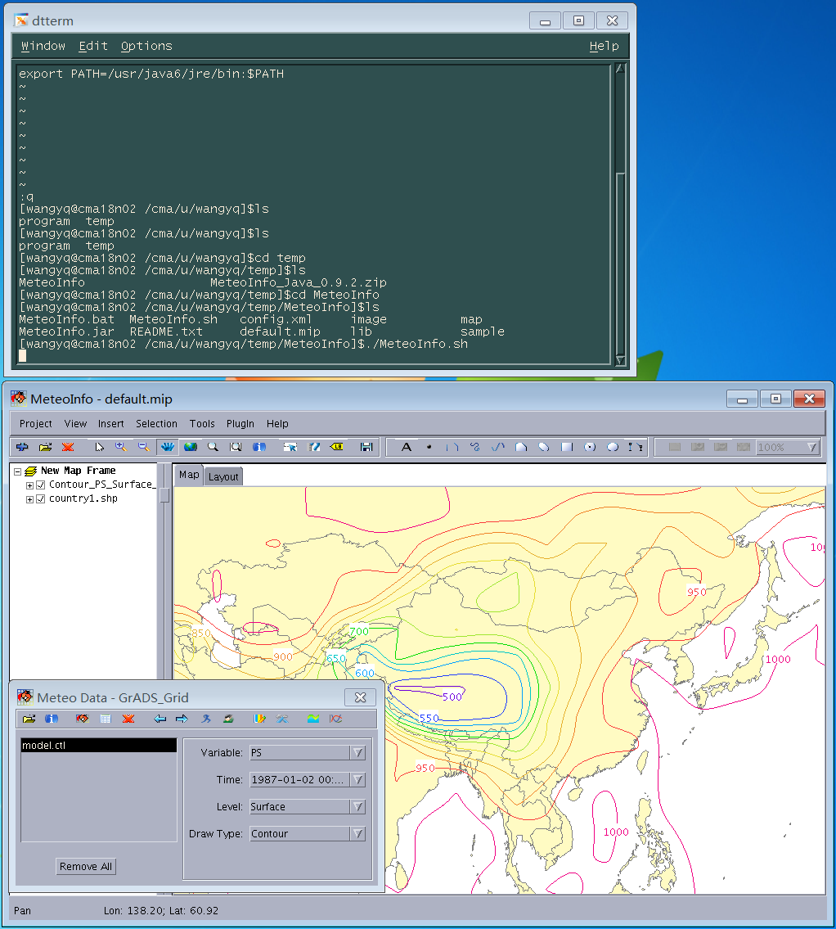
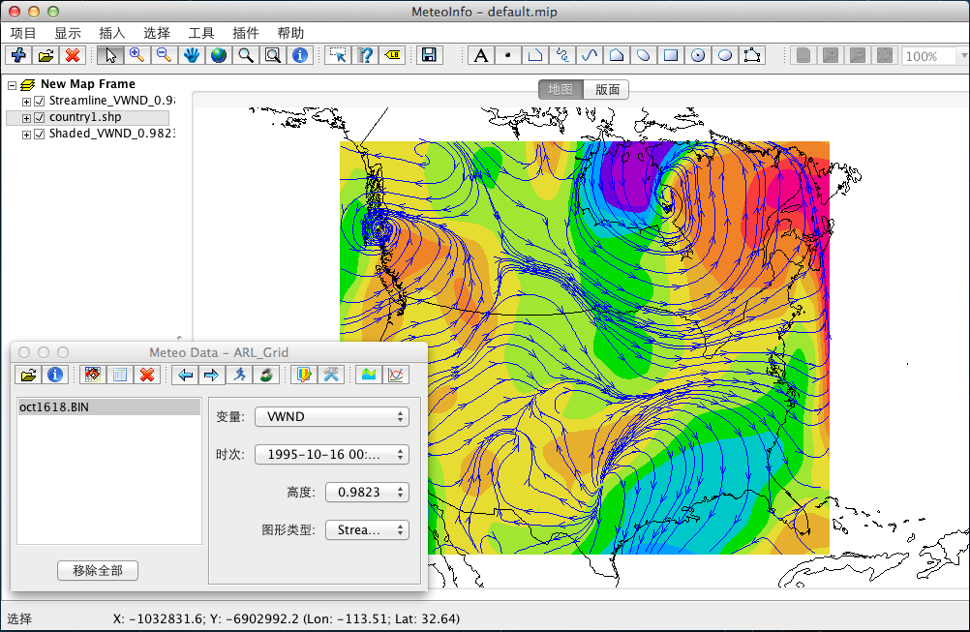
MeteoInfoMap – Spatial and meteorological data operation in a GIS environment
Linux
Windows
Mac OS
Unix

Slide 9
Create meteorological data layers
Grid Data
Station Data
Line Data
Contour
Shaded
Grid Fill
Grid Point
Vector
Barb
Raster
Station Point
Contour
Shaded
Barb
Weather Symbol
Station Model
Station Info
TrajLine
TrajStartPoint
TrajPoint

Slide 10
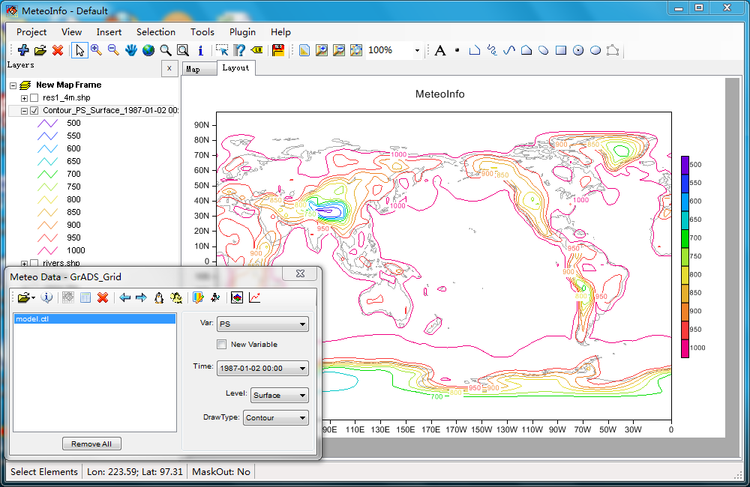
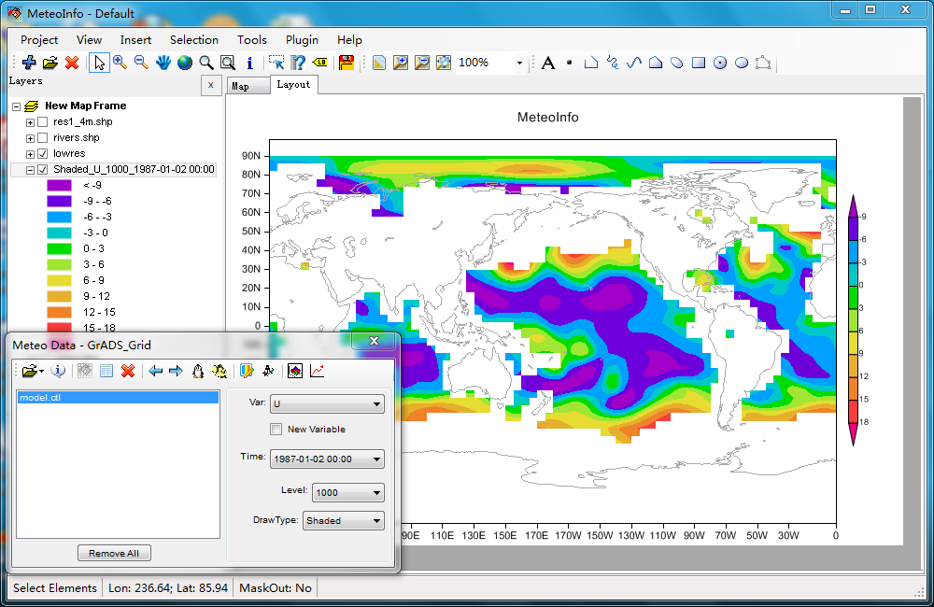
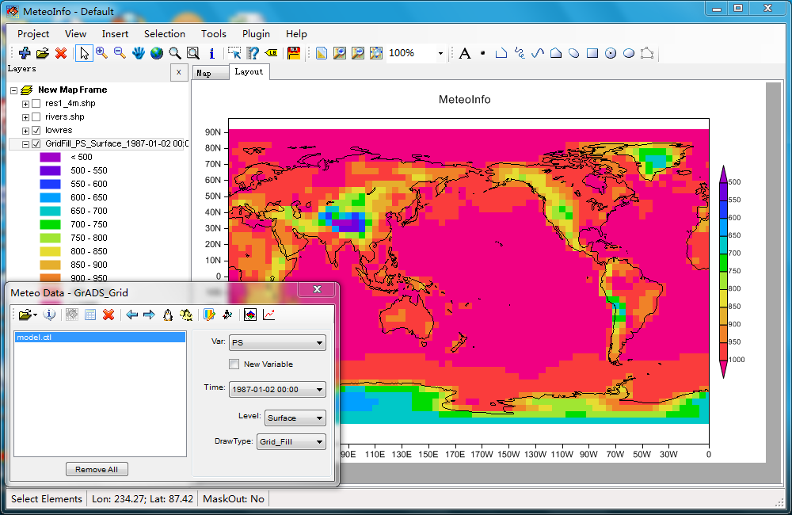
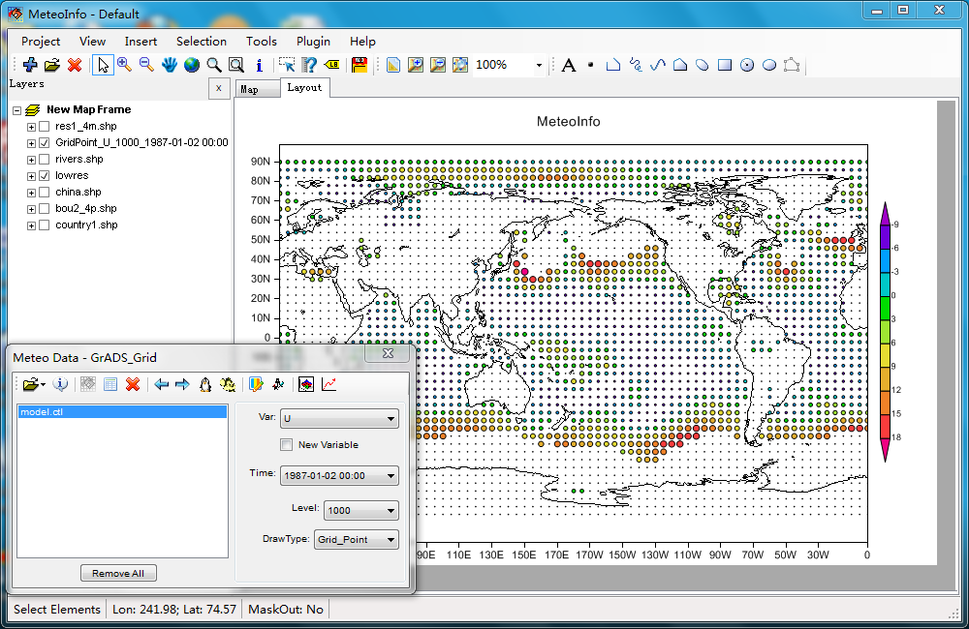
The layers created from grid data

Slide 11
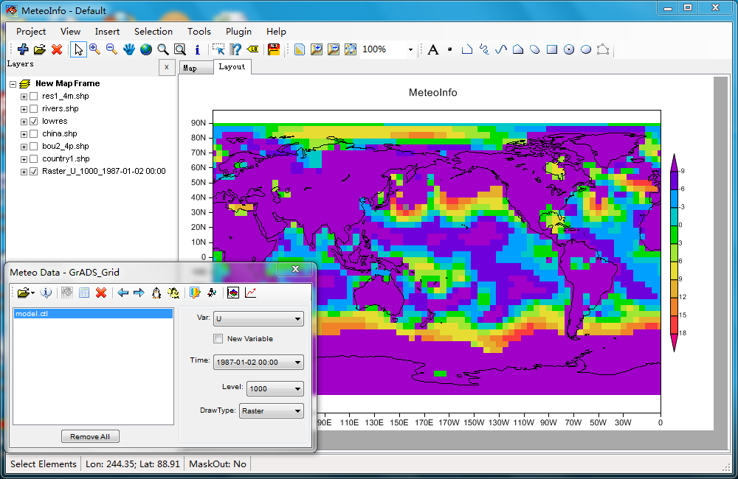
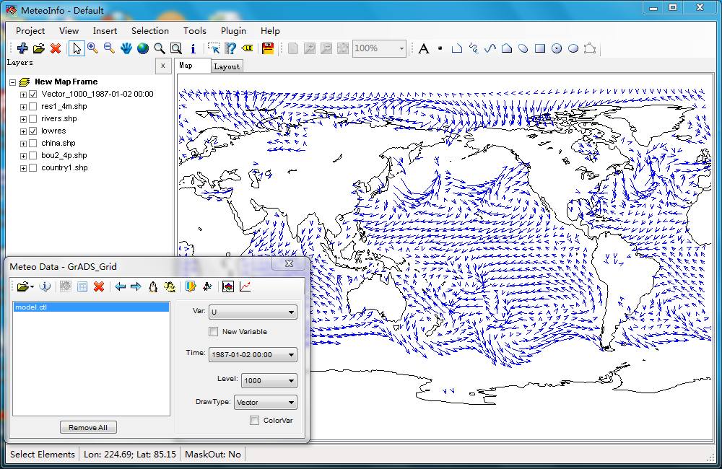
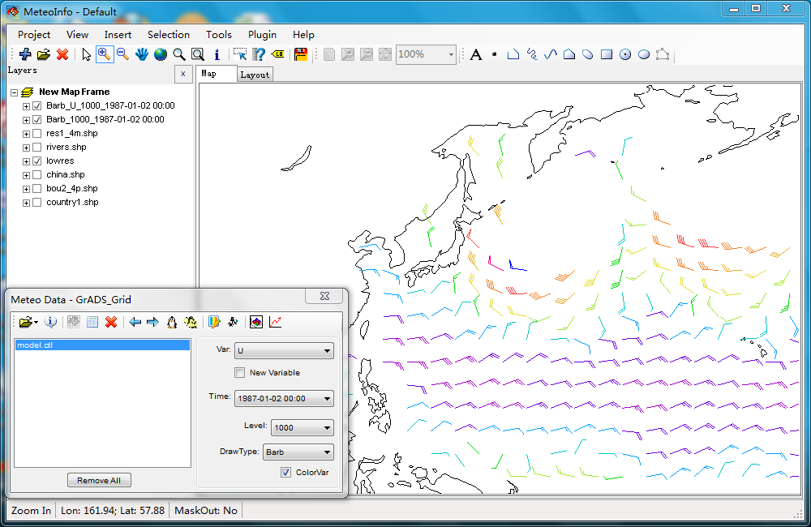
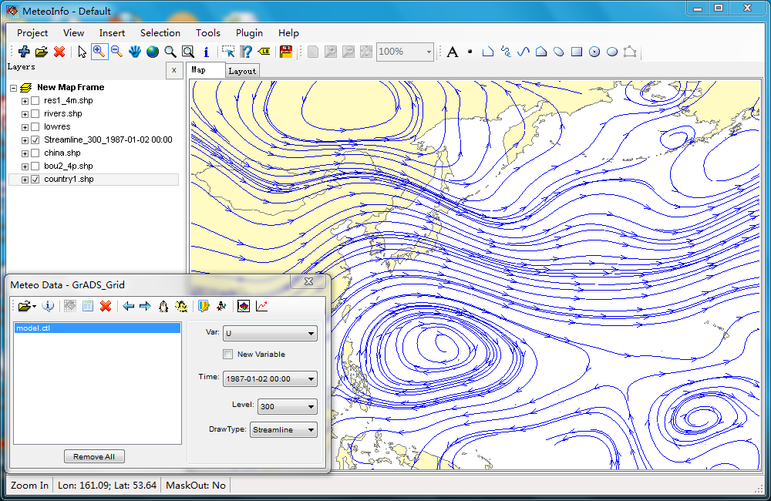
The layers created from grid data

Slide 12
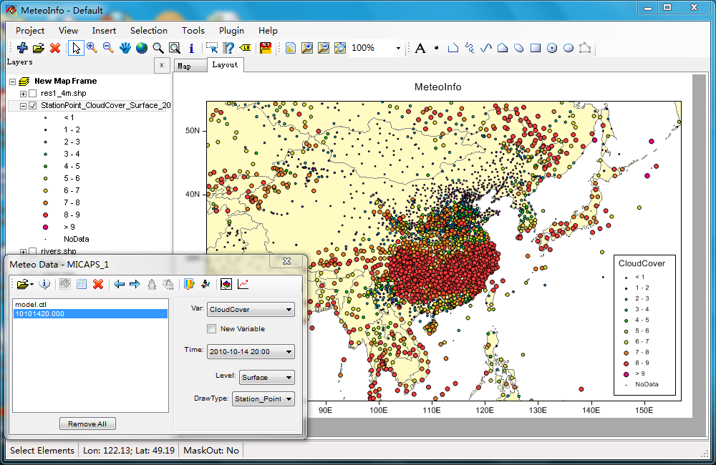
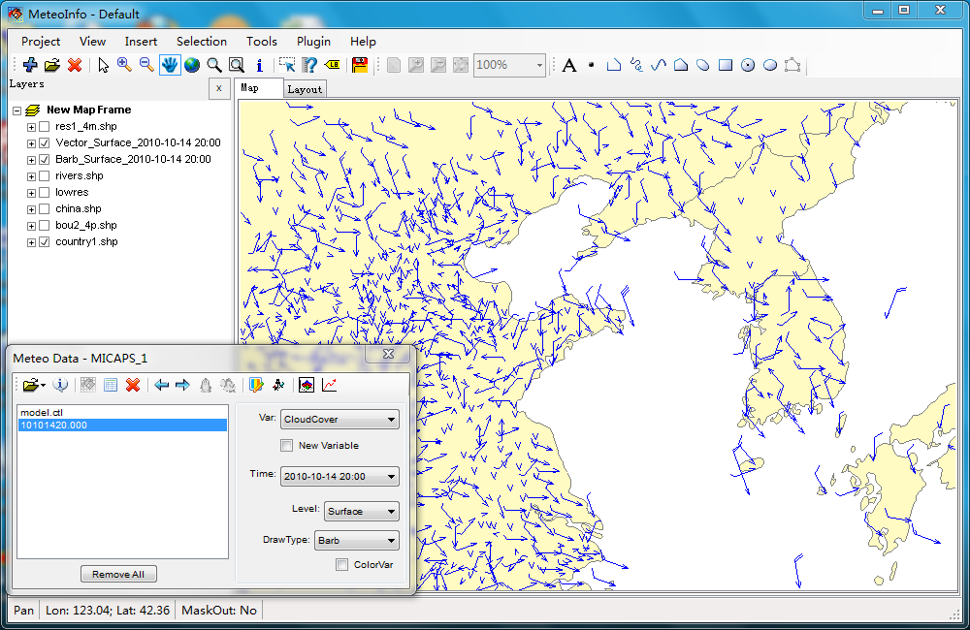
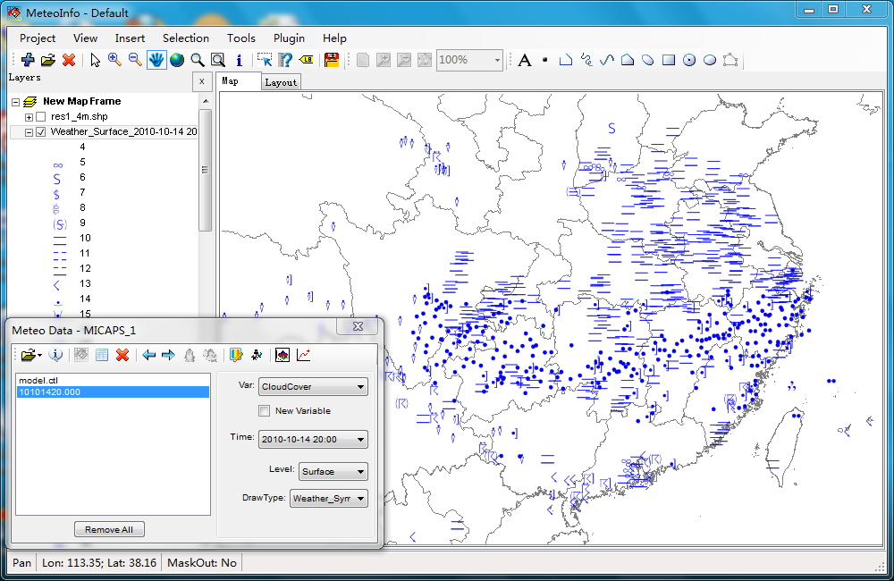
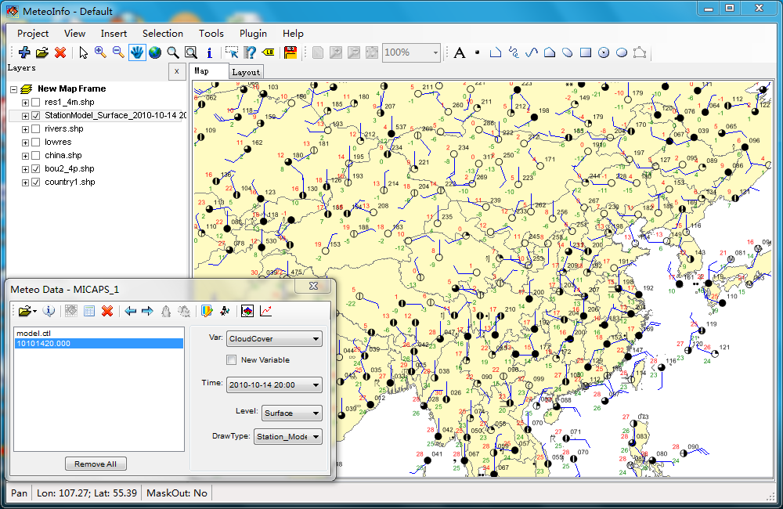
The layers created from station data

Slide 13
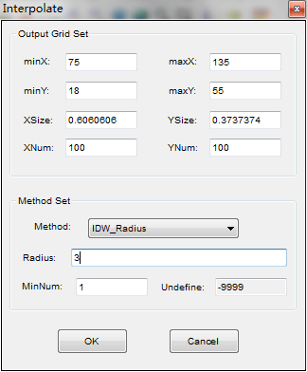
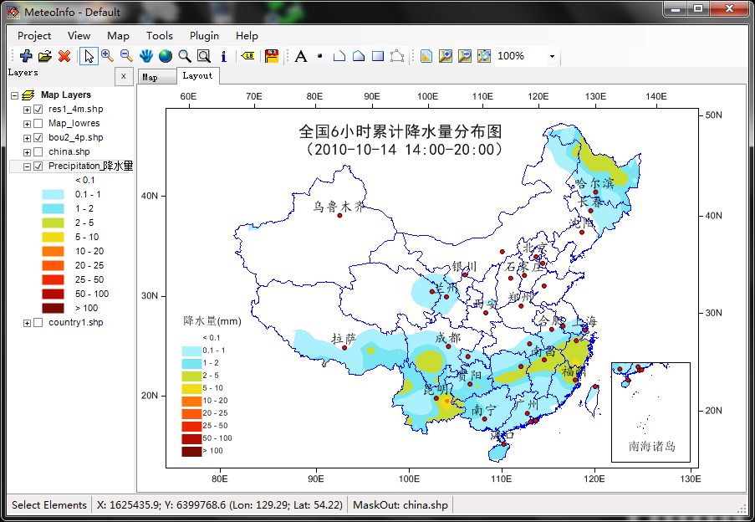
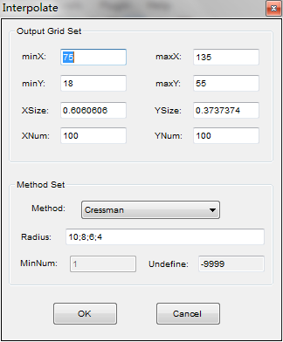
Interpolate station data to grid data, then create contour or shaded layer
Cressman
IDW_Radius
IDW_Neighbors

Slide 14
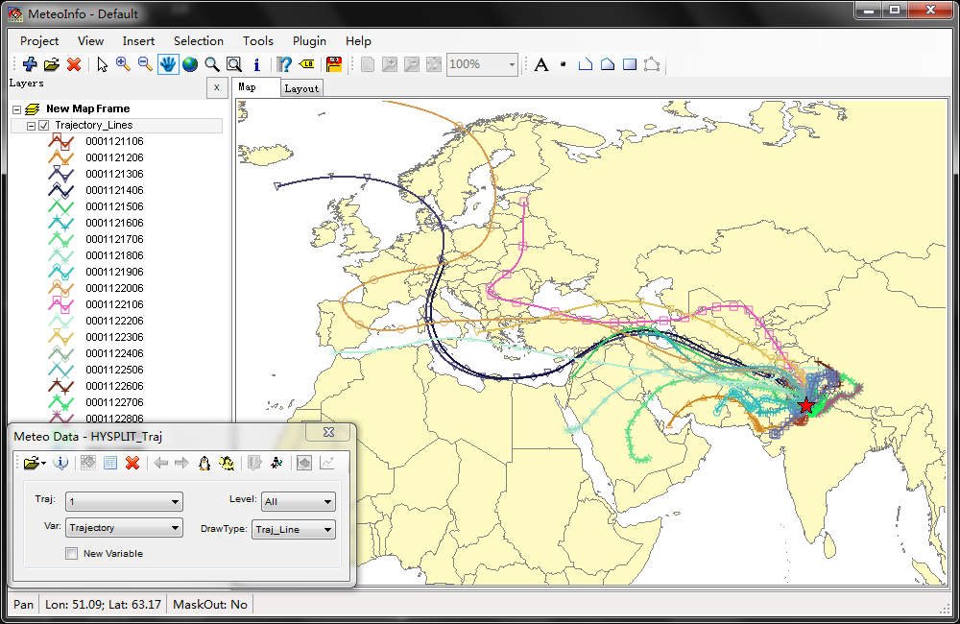
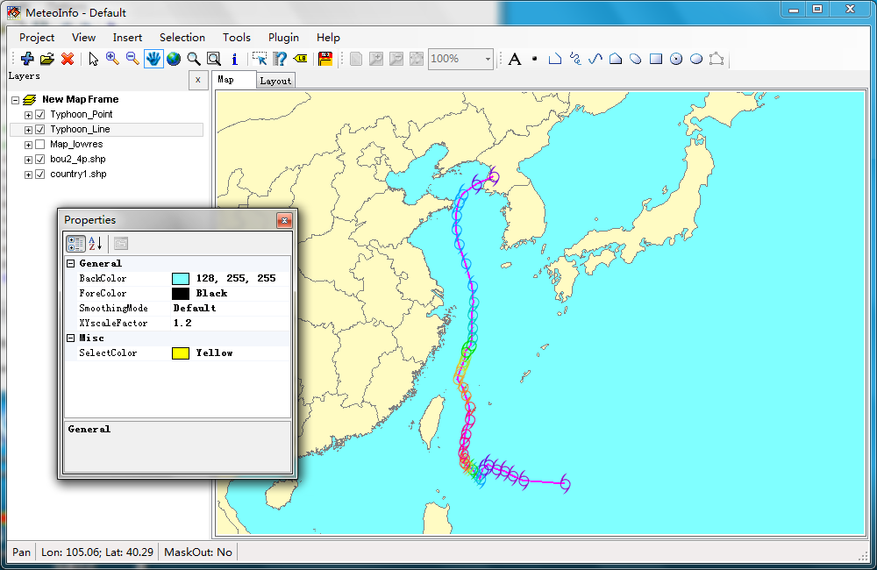
Line data
Trajectory
Typhoon

Slide 15
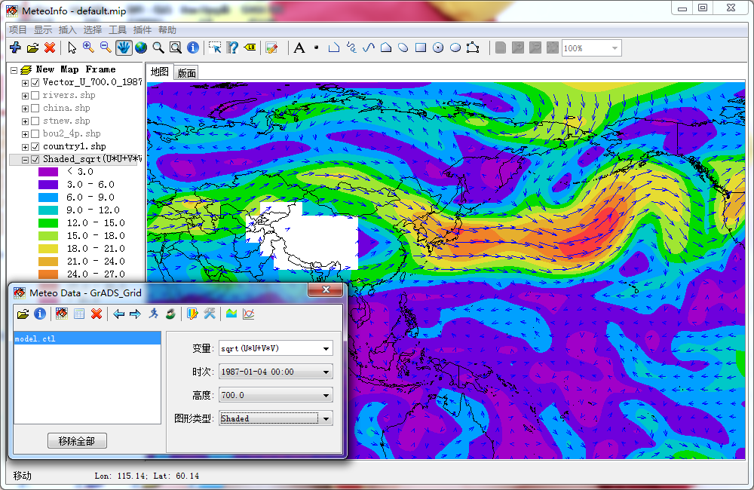
New variable created from existing variables

Slide 16
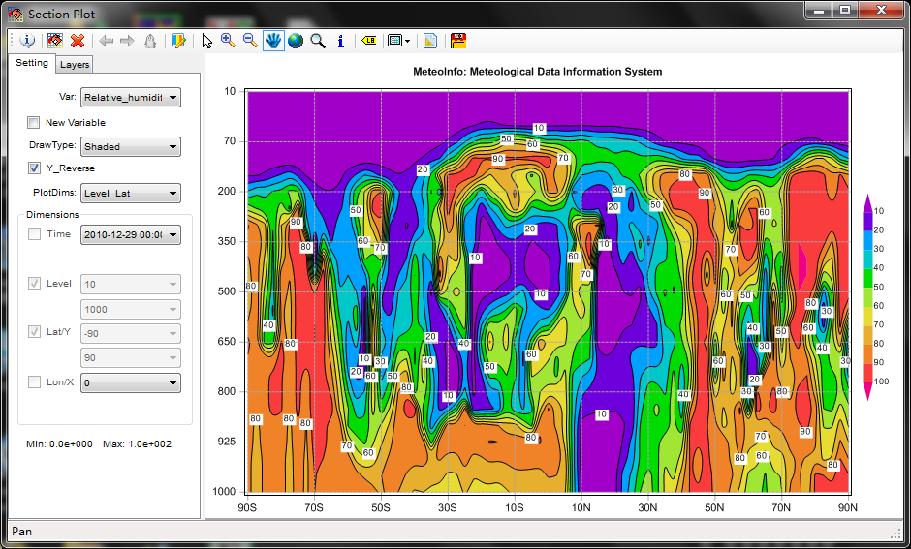
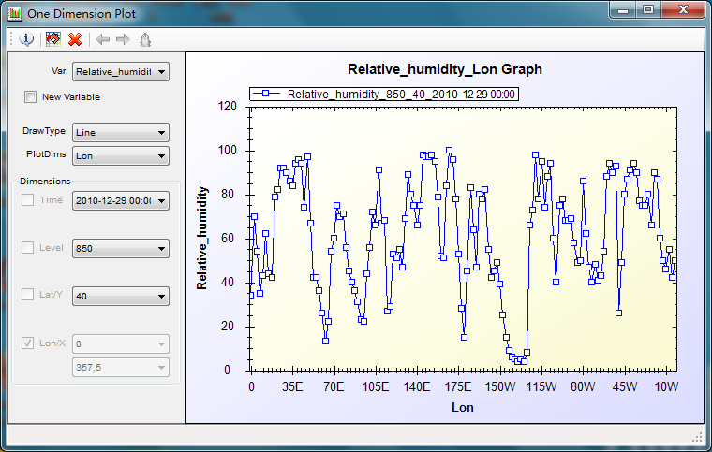
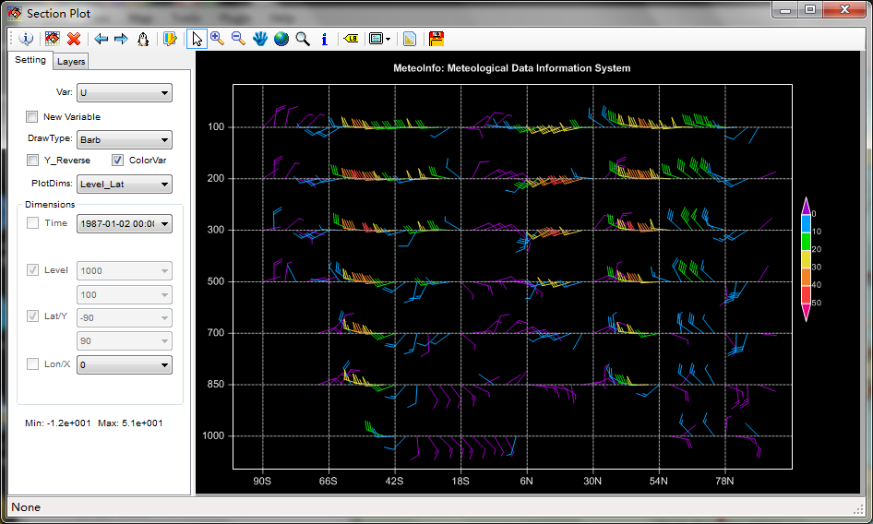
One dimension plot
Section plot

Slide 17
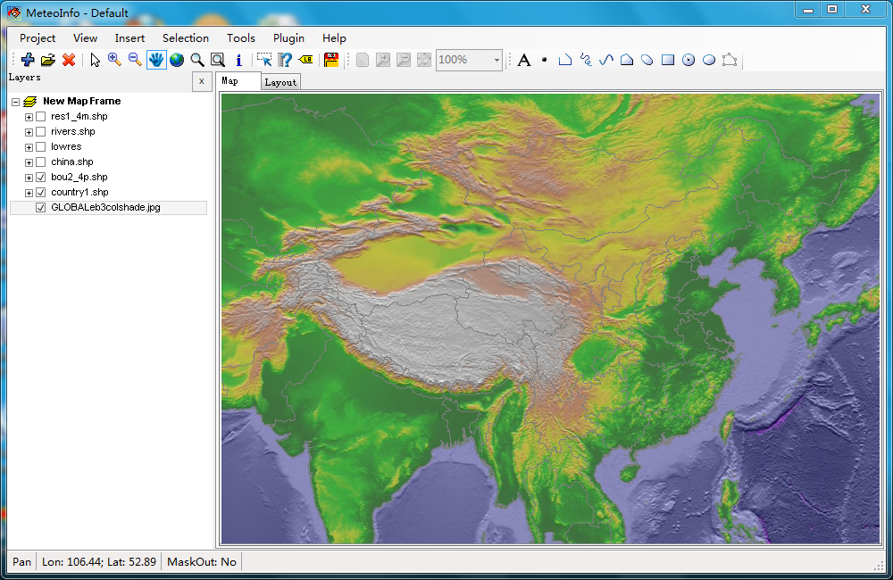
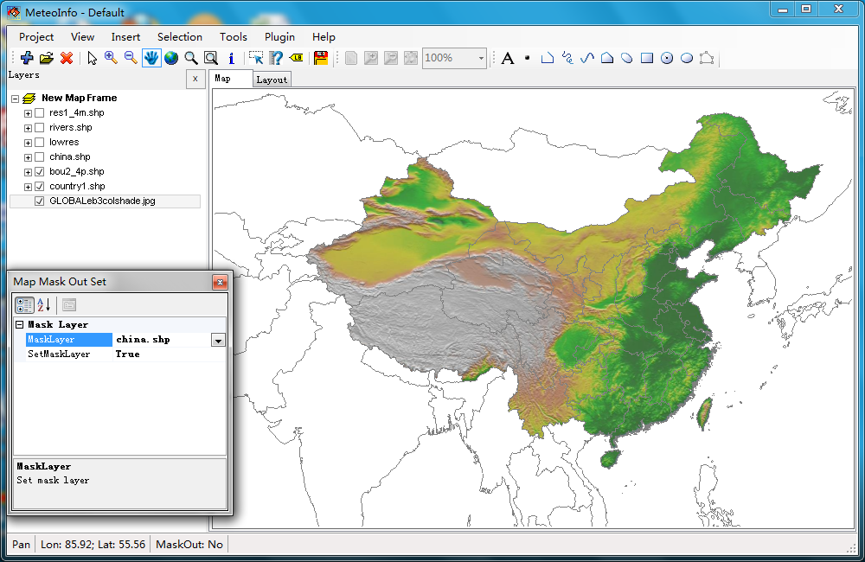
Mask out layer
Each layer has ‘IsMaskOut’ property.
The mask out layer is only validate to the layers with true ‘IsMaskOut’ property. So you can control which layers will be masked out.

Slide 18
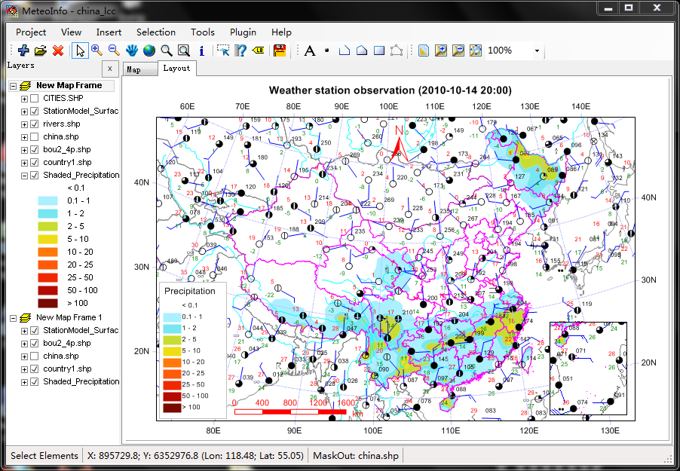
MeteoInfo Layout

Slide 19
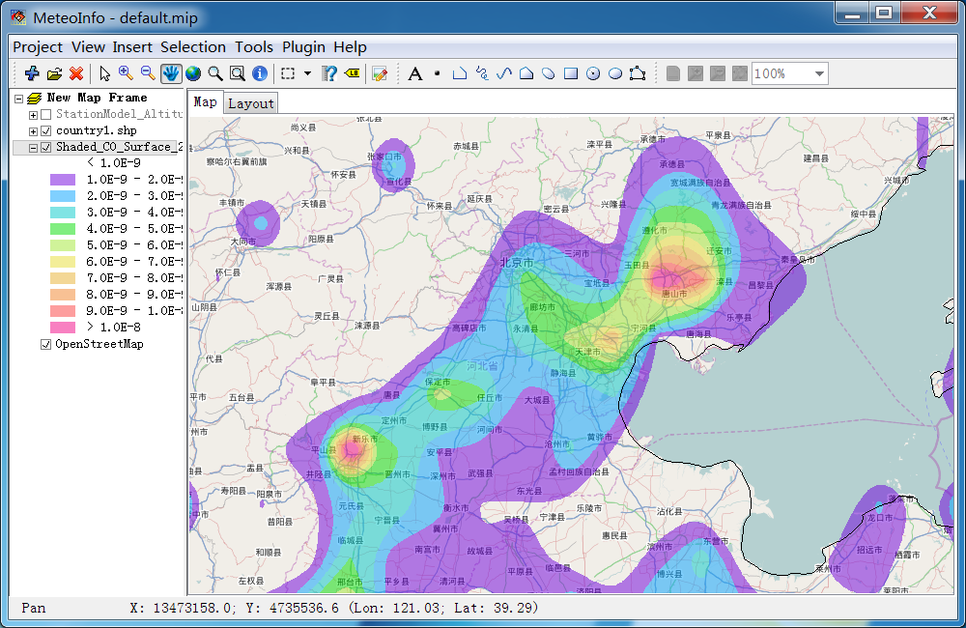
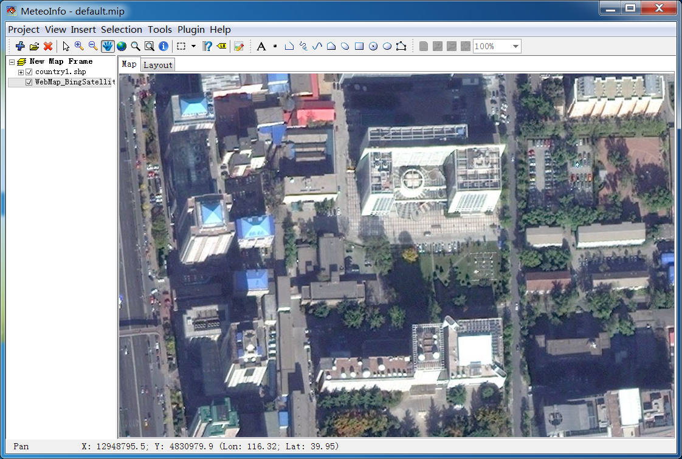
Add web map layer
Mercator projection
- OpenStreetMap
- OpenStreetMapQuestSatellite
- BingMap
- BingSatelliteMap
- BingHybridMap
- GoogleMap
- GoogleSatelliteMap
- GoogleTerrainMap
- GoogleHybridMap
- YahooMap
- YahooSatelliteMap
- YahooHybridMap

Slide 20
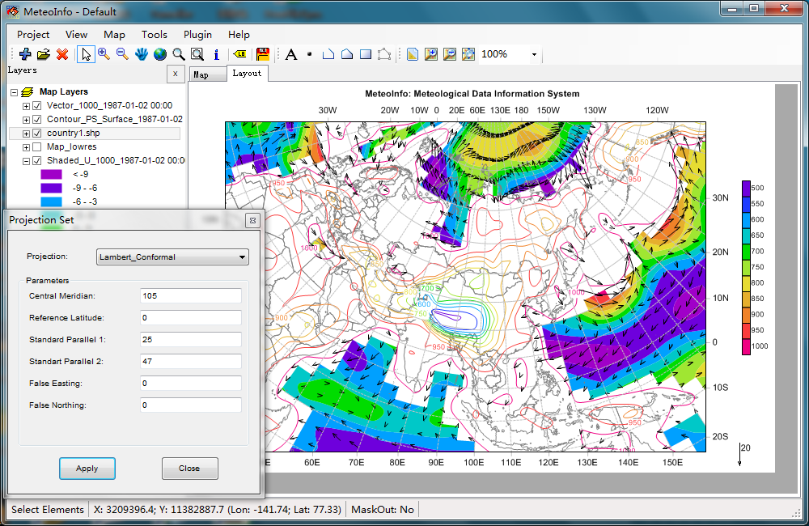
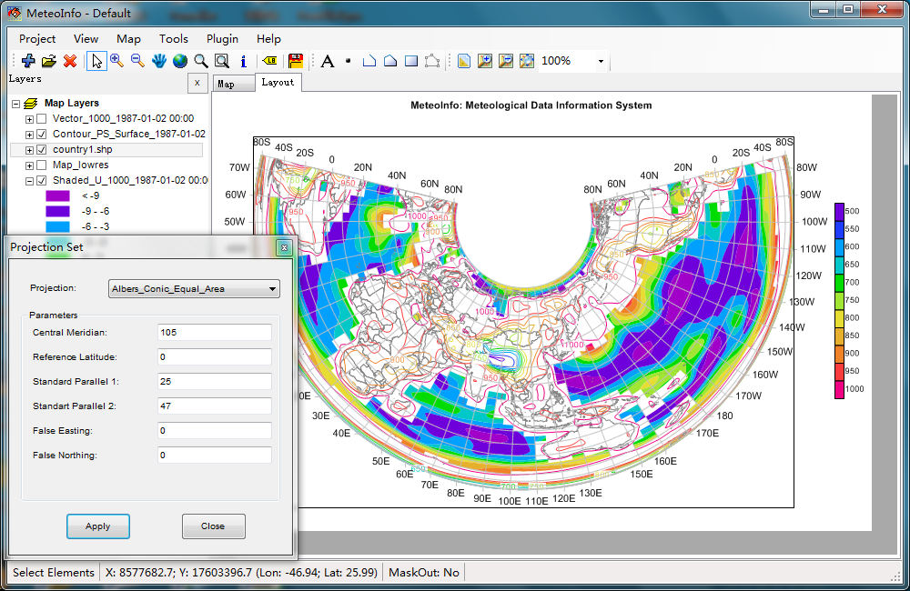
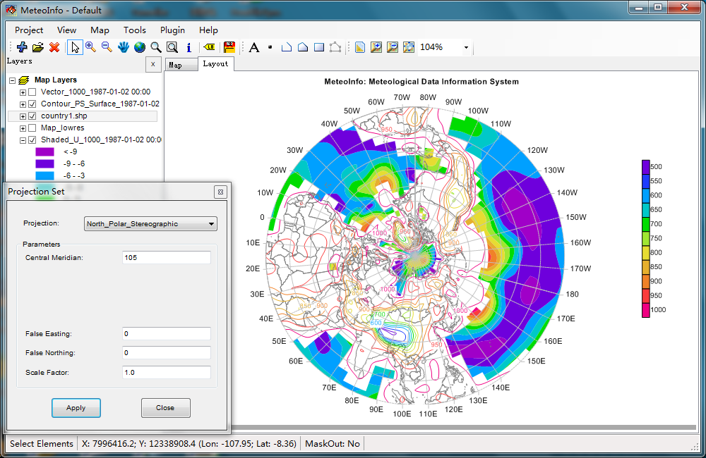
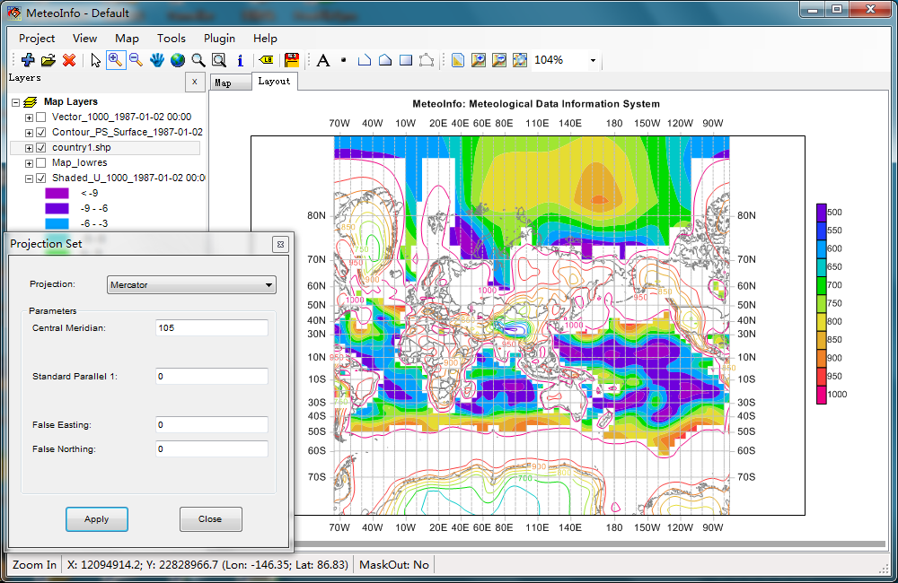
Lambert
Albers
Map projection example
Mercator
Polar Steregraphic

Slide 21
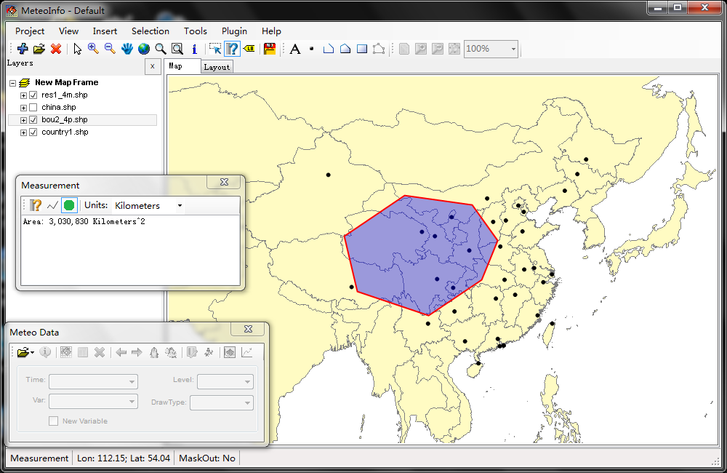
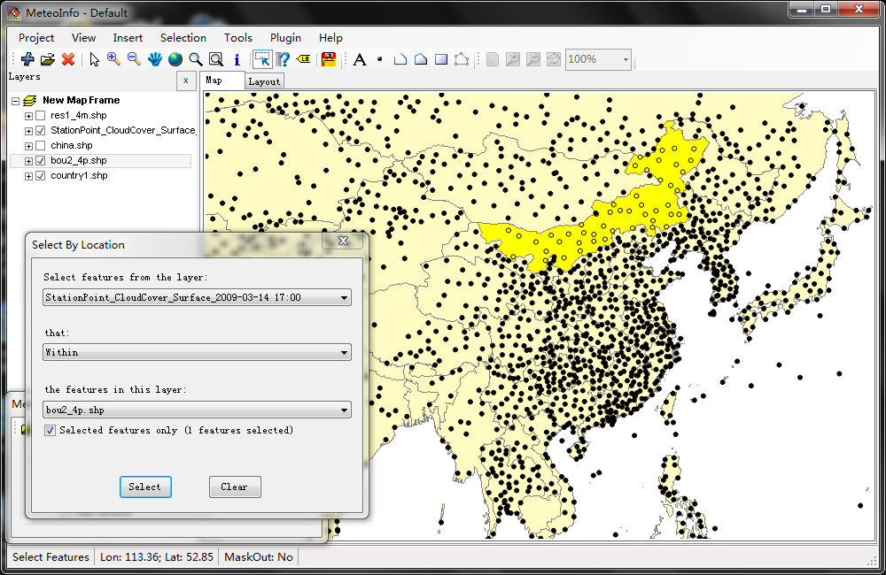
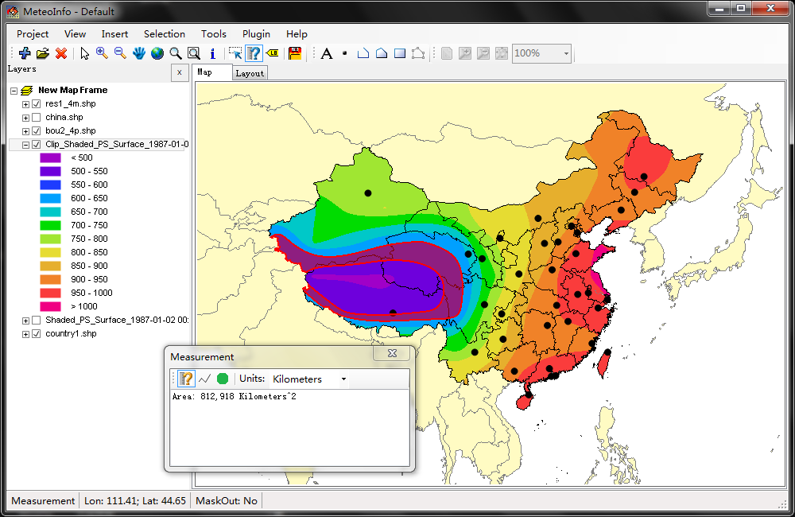
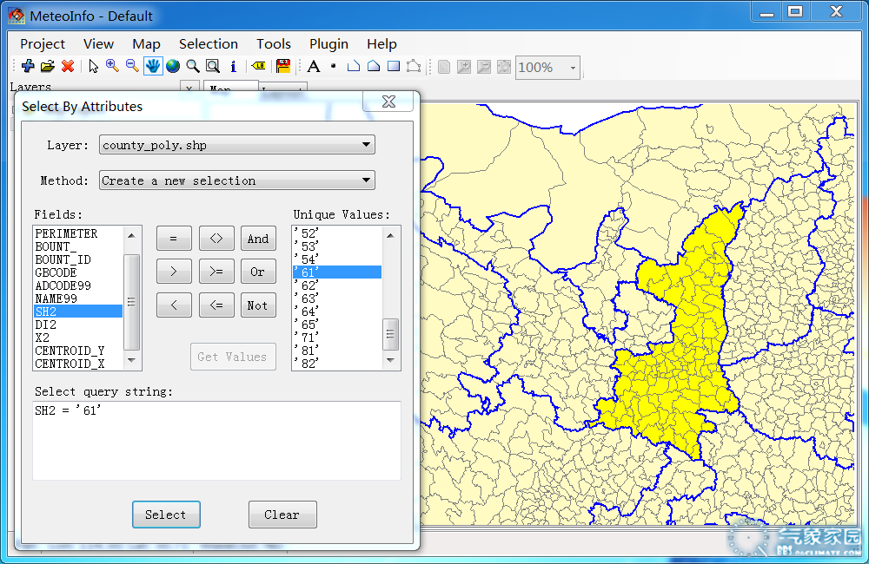
Analysis functions

Slide 22
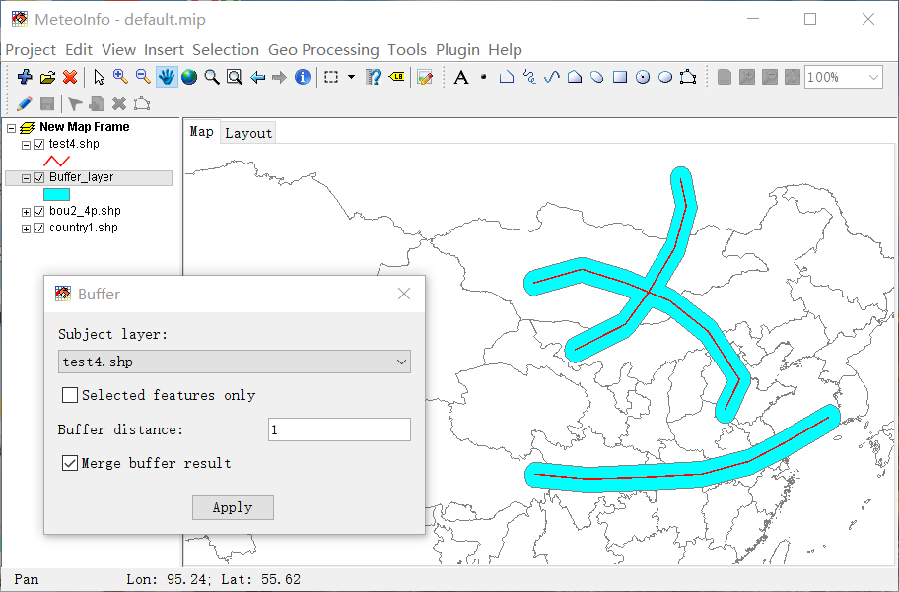
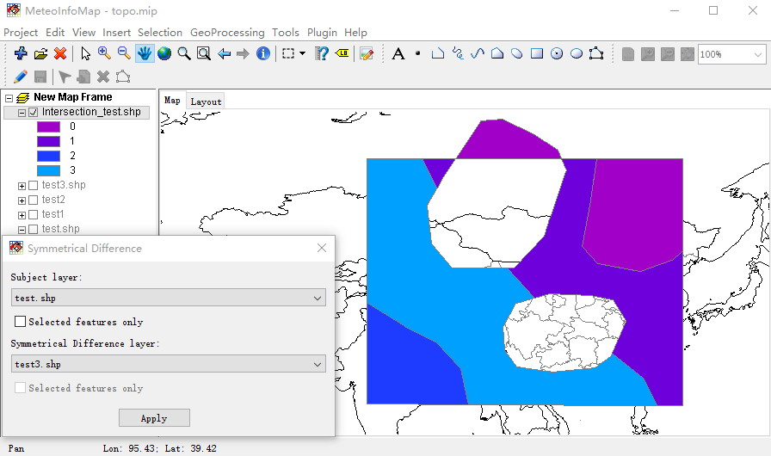
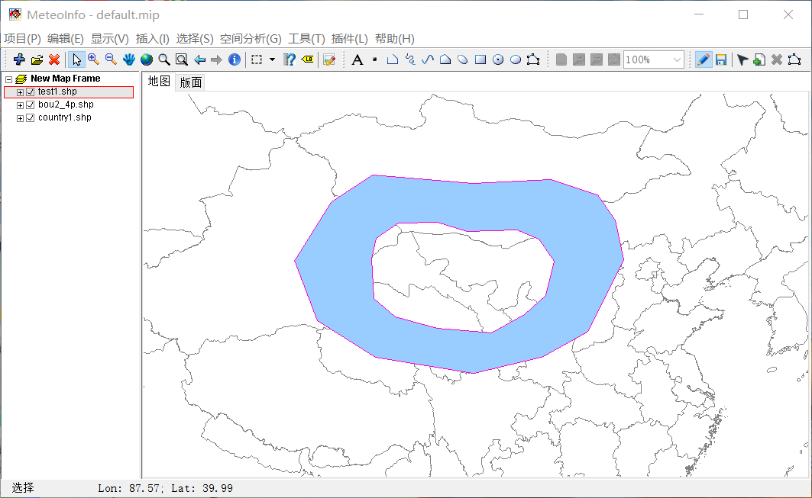
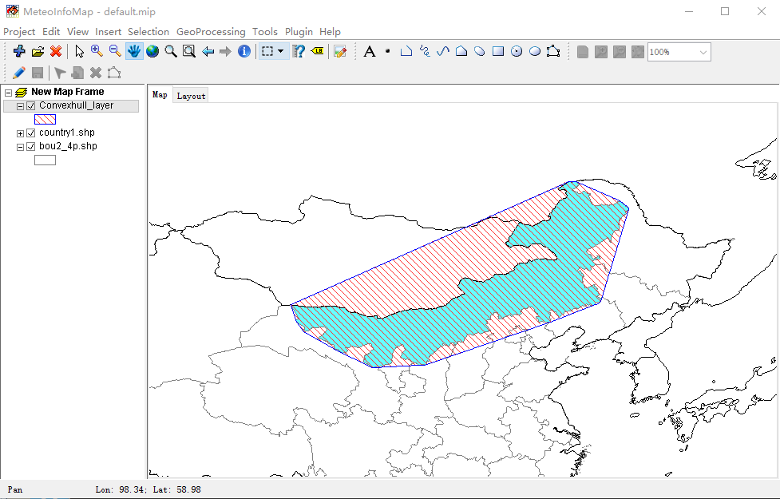
Edit & Geo-processing

Slide 23
MeteoInfoMap demonstration
MeteoInfoMap basic functions
Explore ARL meteorological data file
Open HYSPLIT trajectory end point data file
Open HYSPLIT concentration data file
Open HYSPLIT particle data file

Slide 24
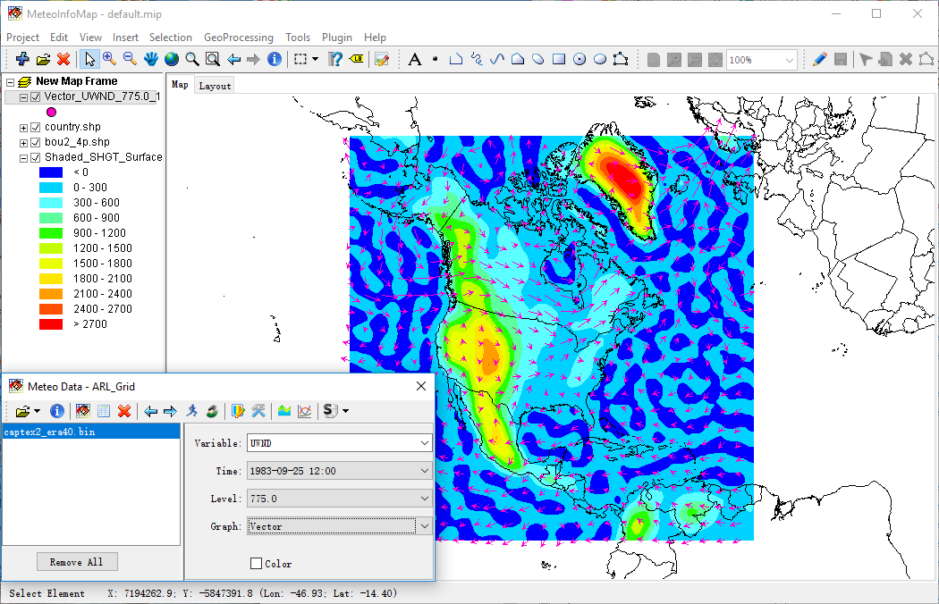
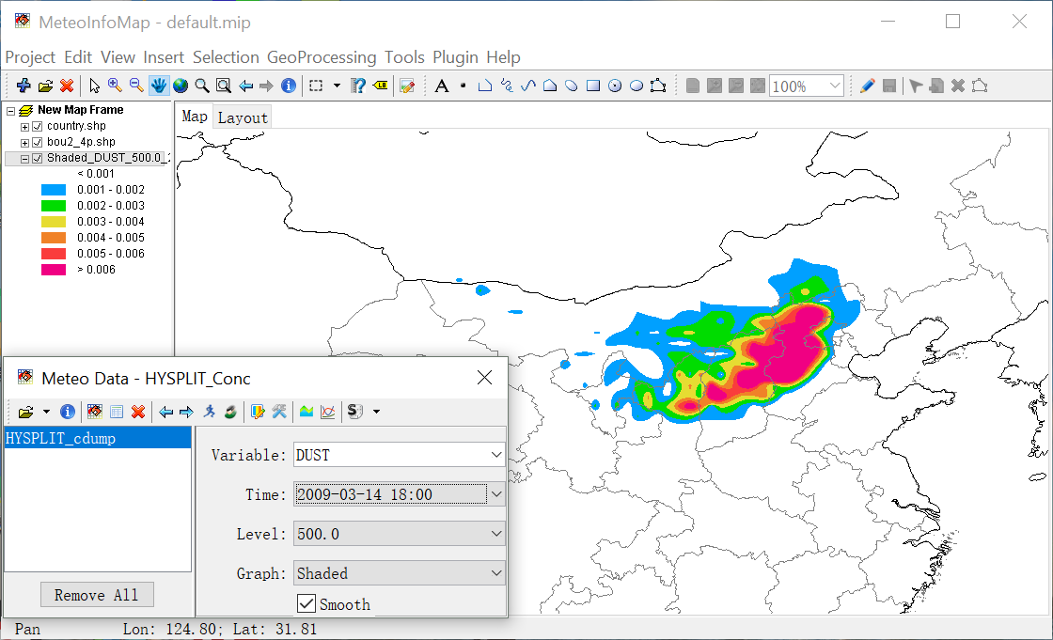
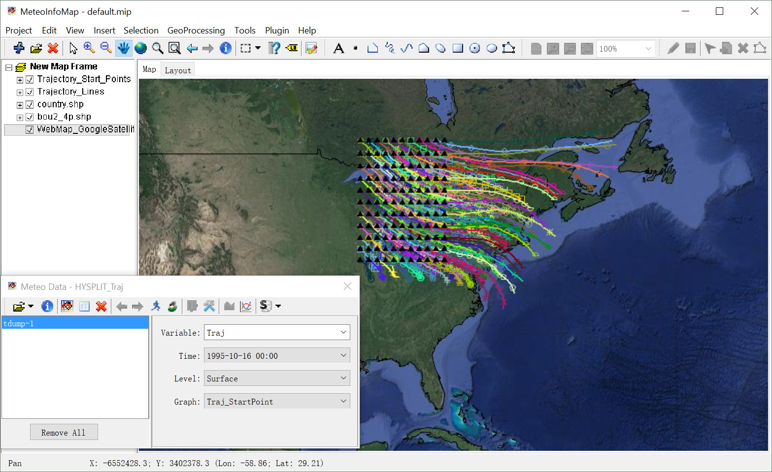
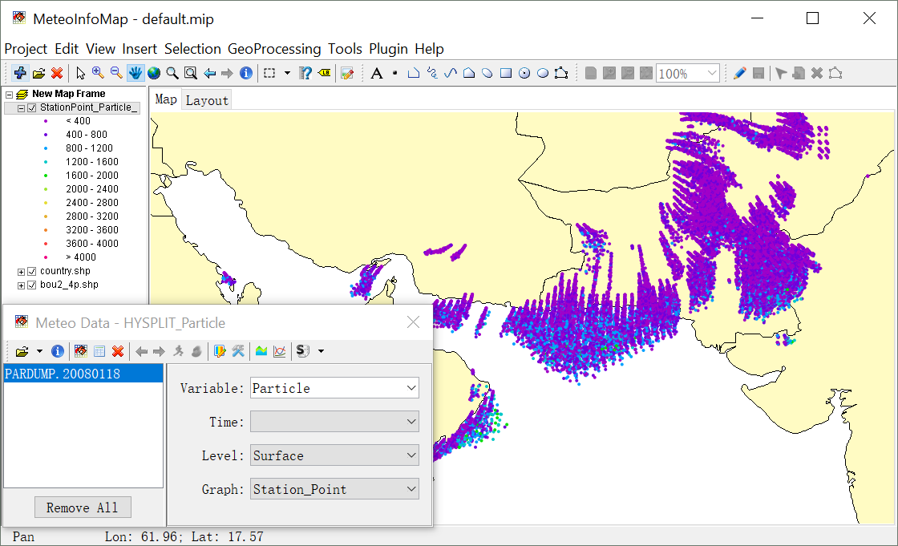

Slide 25
Report content
MeteoInfo introduction
MeteoInfoMap – GIS desktop
TrajStat – Trajectory statistics package
MeteoInofLab – Scientific computation environment

Slide 26

TrajStat framework
TrajStat plugin (open source)
(Wang et al., 2009 EMS)

Slide 27

TrajStat plugin menu

Slide 28

TrajStat – Trajectory calculation

Slide 29


TrajStat – Convert trajectories to shape layer

Slide 30


TrajStat – Show pressure profile

Slide 31


TrajStat – Add observation data into trajectories
This tool will add data from a comma-delimited text file to trajectories according to the date field. The file must contain column titles as the first row and one or two date columns.

Slide 32

TrajStat – Select trajectories according their attributes

Slide 33



TrajStat – Trajectory cluster analysis
Euclidean distance
Angle distance

Slide 34


TrajStat – Trajectory cluster analysis result

Slide 35
Trajectory Clustering
Euclidean Distance
Angle Distance

Slide 36


TrajStat – Cluster statistics

Slide 37



TrajStat – Create grid layer
Before performing PSCF or CWT analysis, a PSCF or CWT grid polygon layer should to be created.

Slide 38
PSCF (Potential Source Contribution Function)
Ashbaugh, 1983; Ashbaugh et al., 1985

Slide 39



TrajStat – PSCF analysis
Ashbaugh, 1983; Ashbaugh et al., 1985

Slide 40
CWT (Concentration Weighted Trajectory)
Seibert et al., 1994

Slide 41



TrajStat – CWT analysis
Seibert et al., 1994

Slide 42
TrajStat demonstration
Trajectory calculation
Add measurement data to trajectories
Vertical trajectory and 3-D view
Select trajectories by attribute
Cluster analysis
PSCF and CWT analysis

Slide 43
Report content
MeteoInfo introduction
MeteoInfoMap – GIS desktop
TrajStat – Trajetory statistics package
MeteoInofLab – Scientific computation environment

Slide 44


Slide 45


MeteoInfoLab GUI

Slide 46


Read array from scientific data file
DimArray

Slide 47


Figure and Axes
Figure contains all plot elements. It has one or more Axes object which is a plot area with a certain coordinate system.
position=[0.13, 0.11, 0.775, 0.815]

Slide 48

Plot function

Slide 49


Multiple axes
subplot & subplots function

Slide 50


Bar chart

Slide 51

LaTeX support

Slide 52


Multiple Y Axis

Slide 53


Scatter, pie plot

Slide 54


box, polar plot

Slide 55



Windrose plot

Slide 56




Plot 2-D array

Slide 57




Plot data in a map

Slide 58




Wind vector, streamline, weather and station model

Slide 59



Meteorological data analysis

Slide 60




Satellite data processing
Himawari-8

Slide 61




MeteoInfo 3-D plot functions
Several 3D plot functions were in Axes3D class, including plot(), scatter(), contour(), contourf(), imshow(), plot_surface(), plot_wireframe() and plot_layer().

Slide 62






MeteoInfo 3-D plot functions - continue

Slide 63
MeteoInfoLab script demonstration
Open and plot ARL data file
Trajectory calculation
Plot trajectory figure – 2D and 3D
Plot HYSPLIT concentration figure
Convert GRIB data to ARL data
Get meteorological data along trajectory

Slide 64




Slide 65
Thanks for your attention!

